Slide 1



Codex F&B Dashboard
View in Power BI
Last data refresh:
7/9/2023 5:08:30 PM UTC
Downloaded at:
7/10/2023 4:13:08 PM UTC
Nilesh Pandey

Slide 2
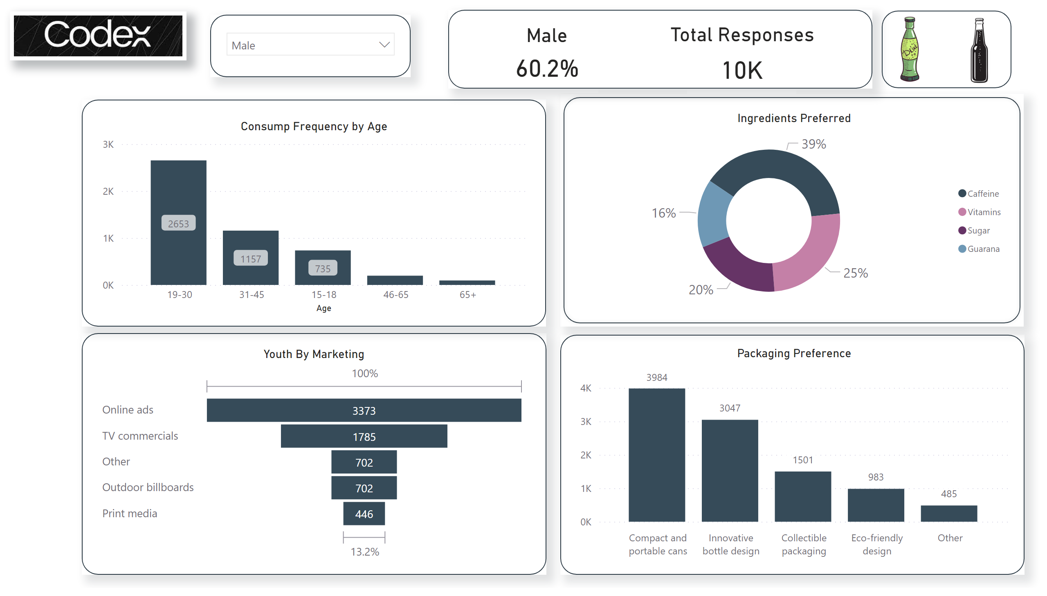
DemoGraphics
Notes:
slicer
No alt text provided
image
No alt text provided
image
No alt text provided
shape
No alt text provided
shape
No alt text provided
shape
No alt text provided
shape
No alt text provided
shape
No alt text provided
shape
No alt text provided
image
No alt text provided
shape
No alt text provided
card
No alt text provided
Ingredients Preferred
No alt text provided
card
No alt text provided
Packaging Preference
No alt text provided
Youth By Marketing
No alt text provided
card
No alt text provided
card
No alt text provided
Consump Frequency by Age
No alt text provided

Slide 3
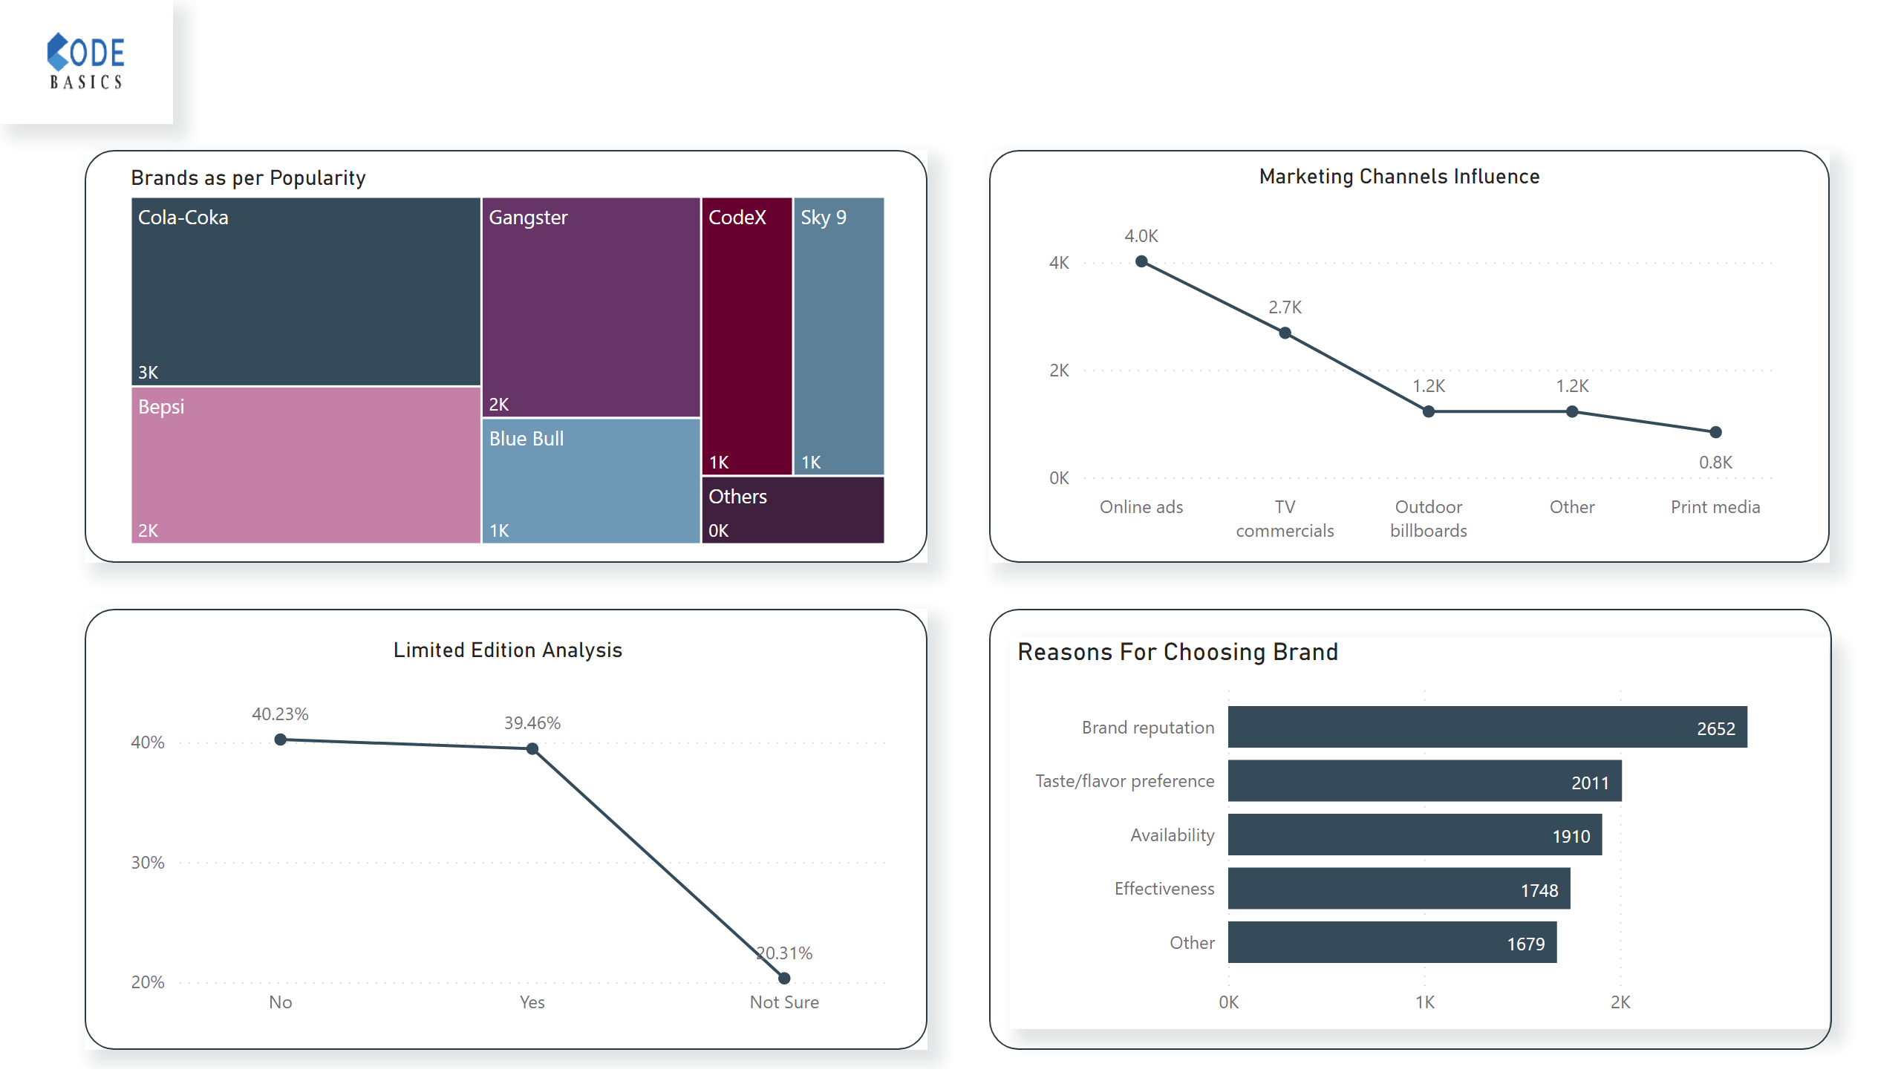
Competiton & Market
Notes:
shape
No alt text provided
shape
No alt text provided
shape
No alt text provided
shape
No alt text provided
image
No alt text provided
Marketing Channels Influence
No alt text provided
Reasons For Choosing Brand
No alt text provided
Limited Edition Analysis
No alt text provided
Brands as per Popularity
No alt text provided

Slide 4
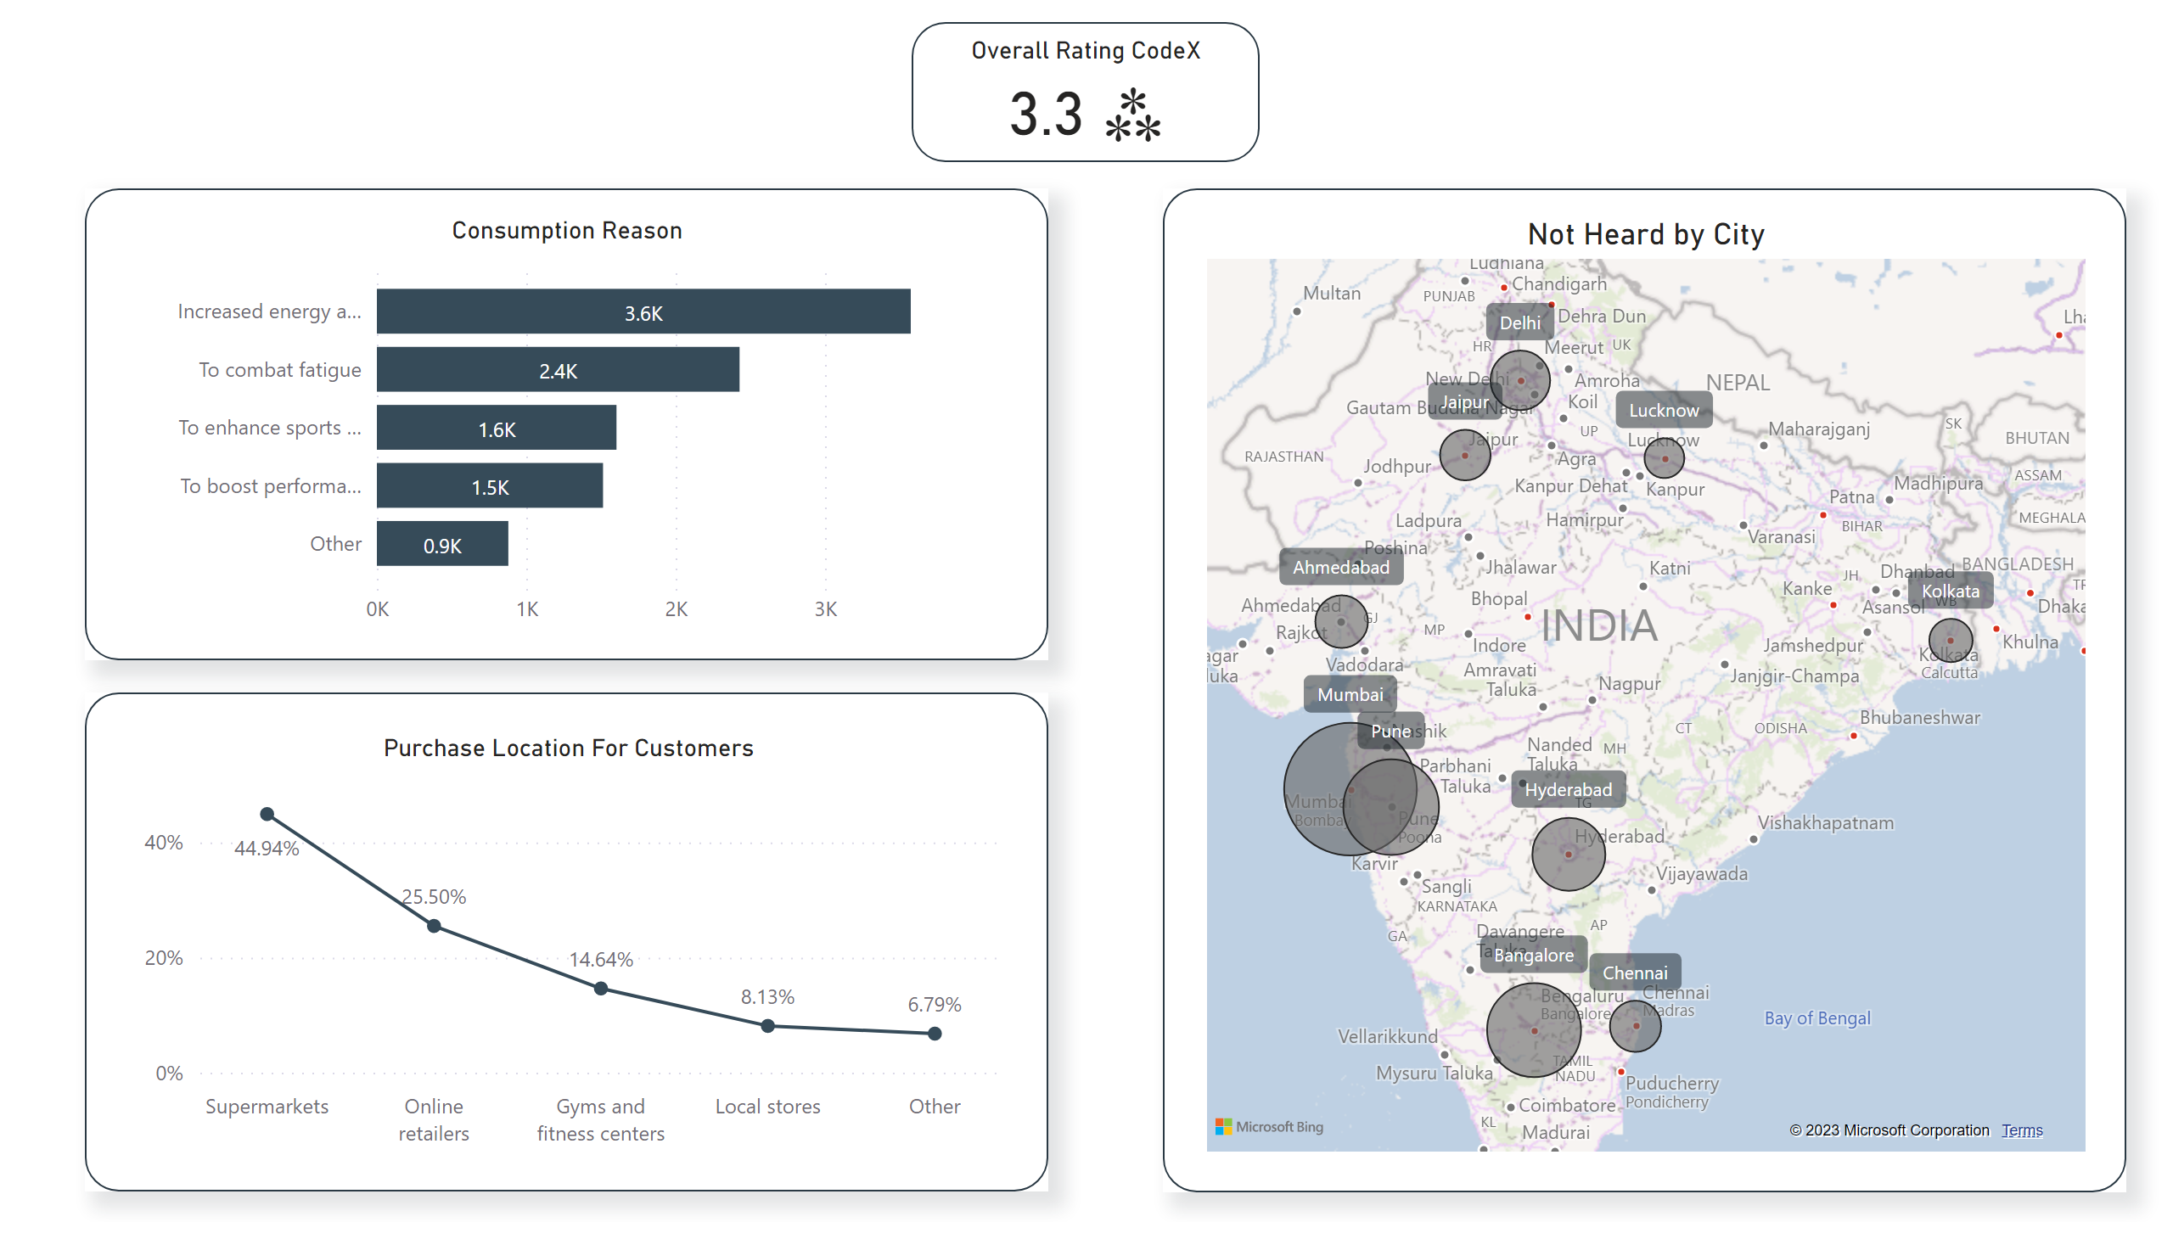
BP & PB
Notes:
shape
No alt text provided
shape
No alt text provided
shape
No alt text provided
shape
No alt text provided
Overall Rating CodeX
No alt text provided
Purchase Location For Customers
No alt text provided
Consumption Reason
No alt text provided
Not Heard by City
No alt text provided

Slide 5
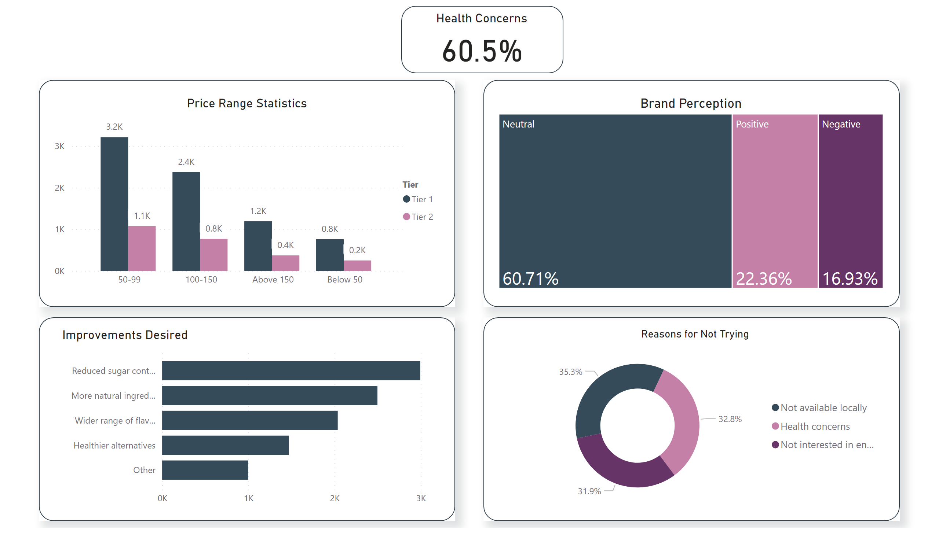
Conclusions
Notes:
shape
No alt text provided
shape
No alt text provided
shape
No alt text provided
shape
No alt text provided
shape
No alt text provided
Improvements Desired
No alt text provided
Health Concerns
No alt text provided
Reasons for Not Trying
No alt text provided
Price Range Statistics
No alt text provided
Brand Perception
No alt text provided

Slide 6
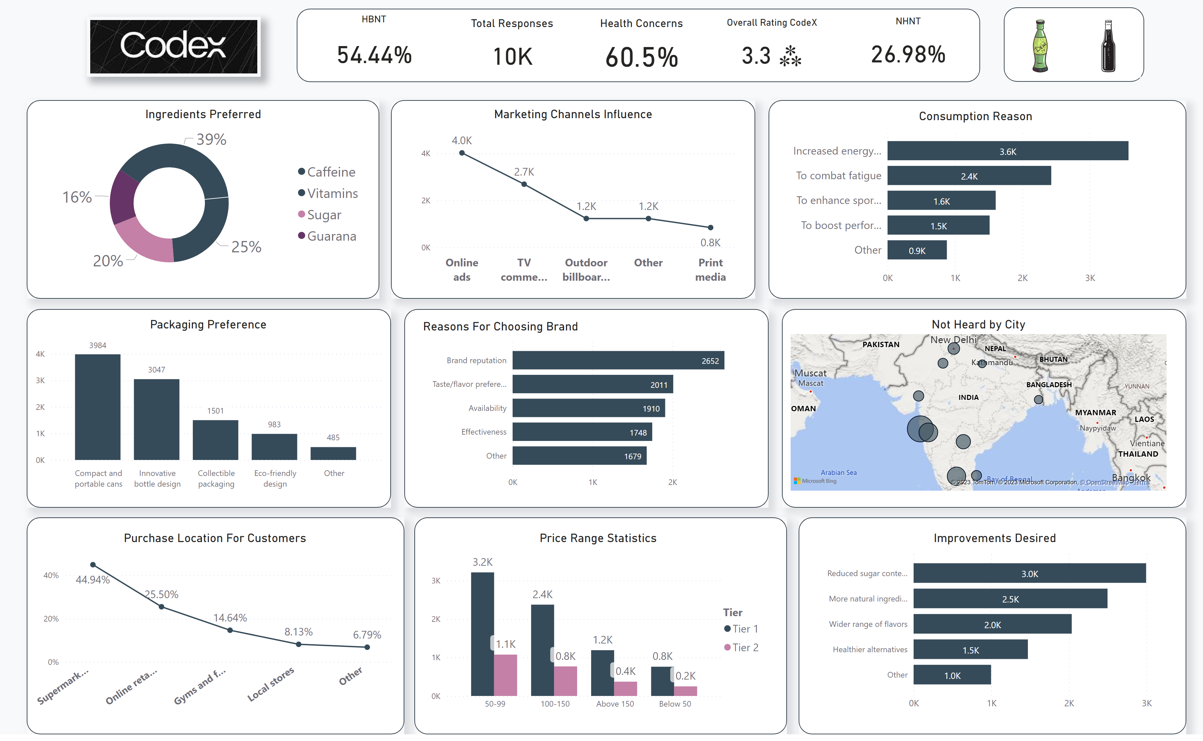
Final
Notes:
shape
No alt text provided
shape
No alt text provided
shape
No alt text provided
shape
No alt text provided
shape
No alt text provided
shape
No alt text provided
shape
No alt text provided
shape
No alt text provided
shape
No alt text provided
shape
No alt text provided
image
No alt text provided
image
No alt text provided
image
No alt text provided
shape
No alt text provided
Ingredients Preferred
No alt text provided
Marketing Channels Influence
No alt text provided
Reasons For Choosing Brand
No alt text provided
Improvements Desired
No alt text provided
Health Concerns
No alt text provided
Price Range Statistics
No alt text provided
Overall Rating CodeX
No alt text provided
HBNT
No alt text provided
Packaging Preference
No alt text provided
Purchase Location For Customers
No alt text provided
NHNT
No alt text provided
Consumption Reason
No alt text provided
Total Responses
No alt text provided
Not Heard by City
No alt text provided

Slide 7
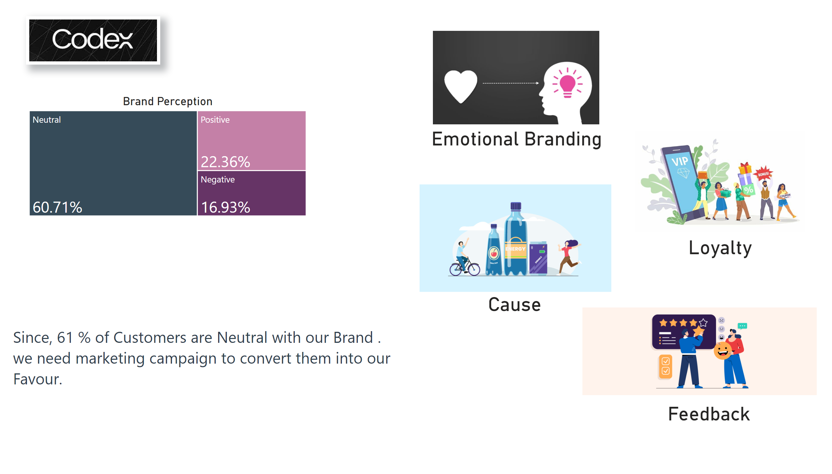
Prescription
Notes:
textbox
No alt text provided
image
No alt text provided
image
No alt text provided
image
No alt text provided
image
No alt text provided
image
No alt text provided
Brand Perception
No alt text provided
card
No alt text provided
card
No alt text provided
card
No alt text provided
card
No alt text provided

Slide 8
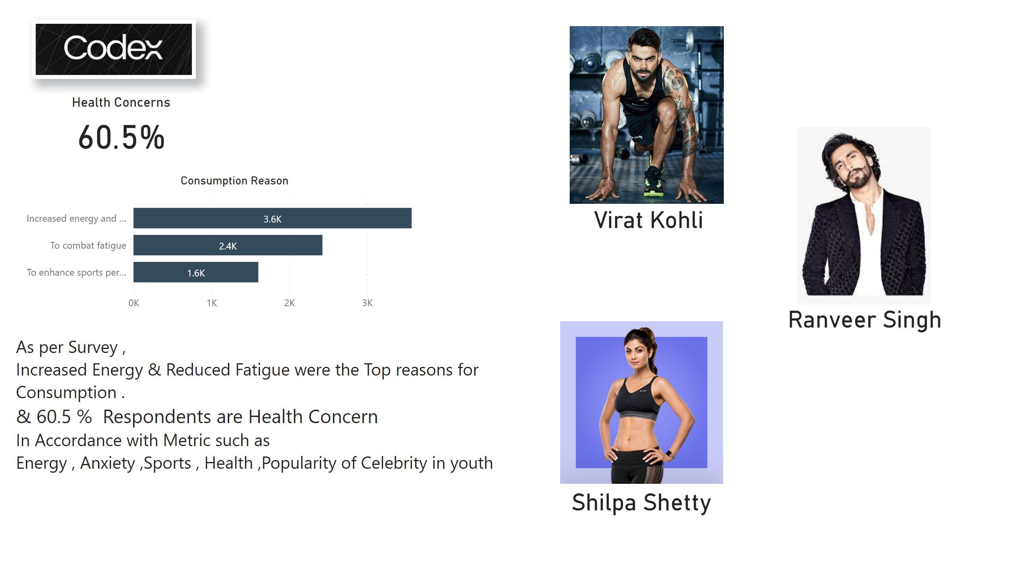
Prescription
Notes:
textbox
No alt text provided
image
No alt text provided
image
No alt text provided
image
No alt text provided
image
No alt text provided
Health Concerns
No alt text provided
card
No alt text provided
card
No alt text provided
card
No alt text provided
Consumption Reason
No alt text provided

